Slide 1
Cloud Technology Fundaments 21UCA501

Slide 2
The Jolicloud Netbook OS
The popularity of ultralight netbooks and mobile phones has greatly expanded the potential audience of dedicated cloud computing devices, but until recently these devices ran standard operating systems such as Windows, Linux, and Macintosh on the PC and Android, IOS, and Windows Mobile (among others) on cell phones. The primary differentiation between these devices is whether or not they are capable of running video and animation (particularly Adobe Flash).
None of these portable devices has been optimized to connect securely to the cloud by narrowing the operating system functions to harden these devices

Slide 3
The Jolicloud Netbook OS
. The French firm Jolicloud (http://www. jolicloud.com/) has recently released a lightweight version of Linux designed specifically to run connected to the cloud as a dedicated cloud client. Jolicloud 1.0 (“The Anywhere OS”) can be
loaded onto a netbook as the only operating system, or it can be set up as a dual boot system that shares files with a Windows partition.
Jolicloud concentrates on building a social platform with automatic software updates and installs.
The application launcher is built in HTML 5 and comes preinstalled with Gmail, Skype, Twitter, interface. Jolicloud maintains a library or App Directory of over 700 applications as part of an app store. When you click to select an application, the company both installs and updates the application
going forward, just as the iPhone manages applications on that device. Figure 3.8 shows the Jolicloud interface.

Slide 4
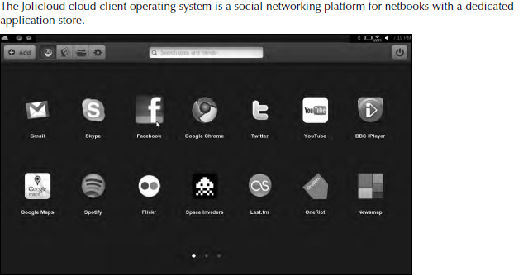
The Jolicloud Netbook OS

Slide 5
The Jolicloud Netbook OS
When you install Jolicloud on multiple devices, the system automatically synchronizes your applications so you are working with the same content on all your devices. You can manage your devices from any cloud-connected device. Your files are also unified in a single location, and the operating system provides access to shared storage cloud services such as box.net, Dropbox, and drop.io, among other services.

Slide 6
THANK YOU

